Slide 1
Extraction and recognition of wiring diagrams

Slide 2
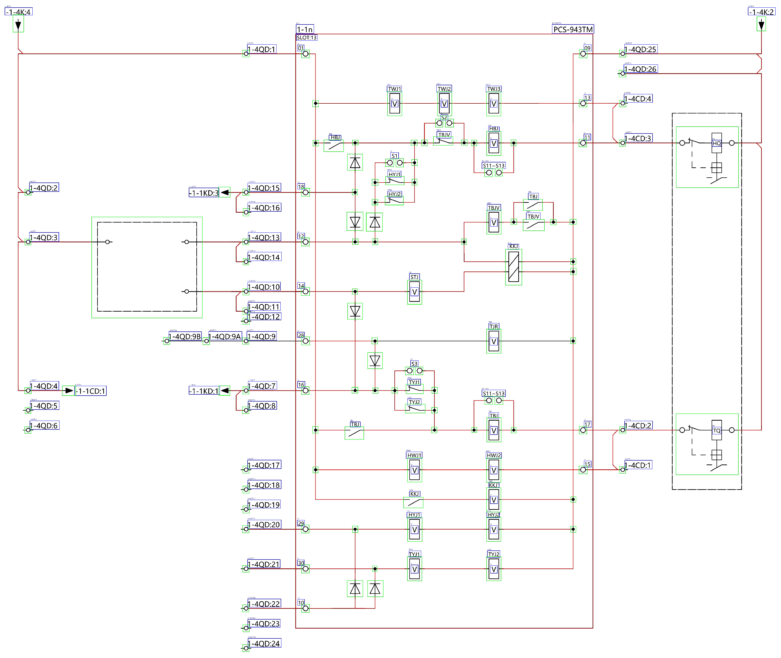
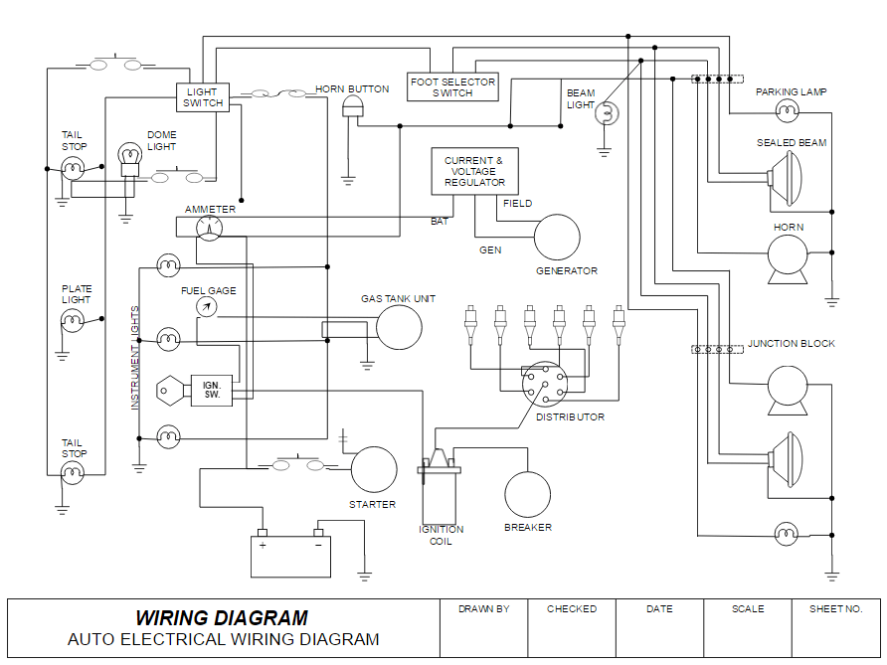
Cao, W.; Chen, Z.; Wu, C.; Li, T. A Layered Framework for Universal Extraction and Recognition of Electrical Diagrams. Electronics 2025, 14, 833. https://doi.org/10.3390/electronics14050833

Slide 3
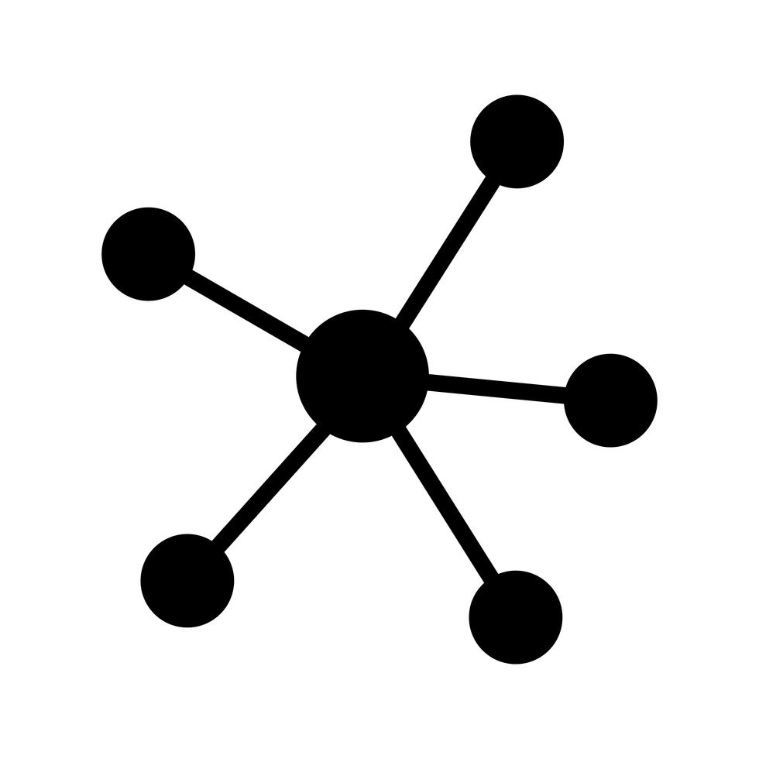

High-level idea
End-to-end process
Problem/Question
Electrical
Schematics
or
Wiring Diagram
or
Piping and Instrumentation
Diagram
Graph DB
(Knowledge Base)
Components, labels and connections detection
Solution

Slide 4

High-level idea
Use case
User: “Parking lamp is not working… what can be the cause?”
AI Assistant, based on the diagram knowledge, may suggest to the user:
Check if there is a loose terminal or a break in the wire between the block and the lamp
Check the light switch because it may have an internal contact worn out.
If the ammeter shows no draw when the switch is flipped, the break is likely at (there is an error internally to the switch) or before the switch (ammeter is disconnected from battery/battery is not working).

Slide 5
State-of-the-art
Recent works on a similar topic
Cao, W.; Chen, Z.; Wu, C.; Li, T. A Layered Framework for Universal Extraction and Recognition of Electrical Diagrams. Electronics 2025, 14, 833. https://doi.org/10.3390/electronics14050833
S. Mani, M. A. Haddad, D. Constantini, W. Douhard, Q. Li and L. Poirier, "Automatic Digitization of Engineering Diagrams using Deep Learning and Graph Search," 2020 IEEE/CVF Conference on Computer Vision and Pattern Recognition Workshops (CVPRW), Seattle, WA, USA, 2020, pp. 673-679, doi: 10.1109/CVPRW50498.2020.00096.
C. -Y. Huang et al., "Netlistify: Transforming Circuit Schematics into Netlists with Deep Learning," 2025 ACM/IEEE 7th Symposium on Machine Learning for CAD (MLCAD), Santa Cruz, CA, USA, 2025, pp. 1-8, doi: 10.1109/MLCAD65511.2025.11189145
Adrian Rahmanto Putra, Sol Ha, Kwang-Phil Park, Automatic extraction of cable connection information from 2D drawings for electrical outfittings design in shipyards, International Journal of Naval Architecture and Ocean Engineering, Volume 16, 2024, ISSN 2092-6782, https://doi.org/10.1016/j.ijnaoe.2024.100630
Hu W, Zhan X, Tong M. Parsing Netlists of Integrated Circuits from Images via Graph Attention Network. Sensors (Basel). 2023 Dec 30;24(1):227. doi: 10.3390/s24010227
Charles R. Kelly, Jacqueline M. Cole; Digitizing images of electrical-circuit schematics. APL Mach. Learn. 1 March 2024; 2 (1): 016109. https://doi.org/10.1063/5.0177755

